Slide 1
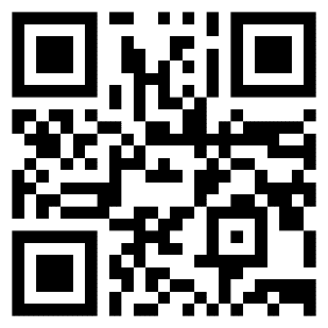
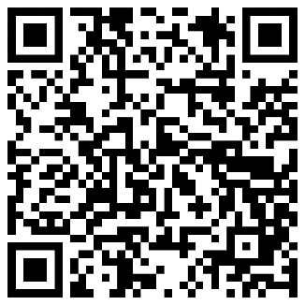
Semi-Supervised Federated Learning for Keyword Spotting
Presenter: Enmao Diao
Paper
Code
Enmao Diao Eric Tramel
Jie Ding Tao Zhang
Notes:
Hello, my name is Enmao Diao. Today, I will be presenting our work on semi-supervised federated learning for keyword spotting. This research was carried out in collaboration with Eric Tramel, Jie Ding, and Tao Zhang.

Slide 2
Outline
Related works
Our approach
Experiments
Takeaways
Notes:
Our presentation today will proceed as follows: We'll start with an introduction to the background of Federated Learning. Afterward, we will discuss existing studies. We will then outline our problem scenario and the challenges we faced during our work. Subsequently, I will introduce our semi-supervised federated learning method for Keyword Spotting and present the results of our experiments on a public dataset and an internal wakeword dataset. Lastly, we will conclude and discuss potential avenues for future research.

Slide 3
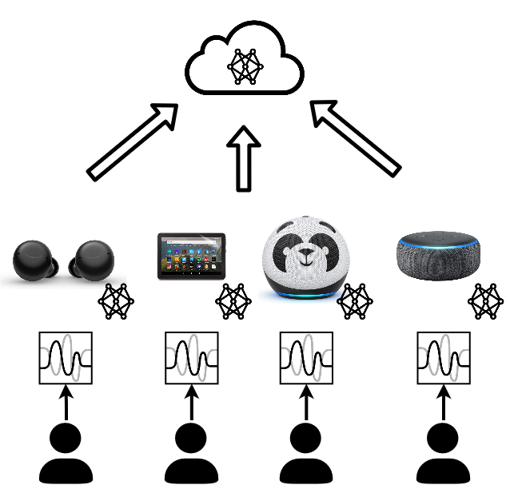
Federated Learning (FL)
Motivation
Local training without data sharing
Local computation resources
Challenges
Data heterogeneity
Statistical
Supervision
System Heterogeneity
Computation
Communication
Personalization, Privacy, Fairness, Security
Notes:
Federated Learning allows machine learning models to leverage the computational resources and private data of numerous distributed devices for their training. The overarching goal of Federated Learning is to expedite and scale the training of distributed machine learning models. In this study, we focused on its application for Keyword Spotting (KWS), which plays a vital role in audio-based applications on mobile devices and virtual assistants.
Existing Federated Learning solutions present various challenges. Among them are data heterogeneity - where local clients possess dissimilar local data, and statistical heterogeneity - where data across all clients are spread in a Non-IID fashion. For instance, each client may only have a subset of labels or imbalanced labels. In our work, we concentrated on supervision heterogeneity, where local data is entirely unlabeled while the server possesses some labeled data.

Slide 4

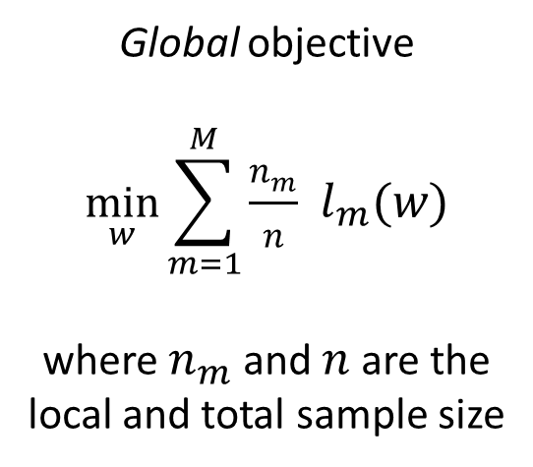
Federated Learning (FL)
Algorithm
Global objective
$$\min_{w}{\sum_{m=1}^{M}{\frac{n_{m}}{n} }l_{m}(w)}$$
where $n_{m}$ and $n$are the local and total sample size
Local objective
local data $X_{m}$ and target $y_{m}$across $M$ devices
perform local update:
$$\min_{w}{\sum_{\left(x,y\right)∈(X_{m},y_{m})}{l_{m}(x, y;w)}}$$
where $l\left(⋅\right)$ is the loss function and $w$ is the model parameter
Notes:
The objective of Federated Learning is twofold. On a global scale, it aims to minimize the empirical risk across all clients. On a local scale, it aims to minimize the empirical risk of local data.

Slide 5
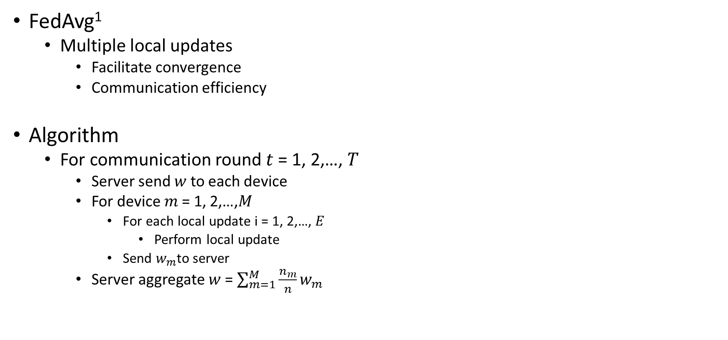
Related works
FedAvg¹
Multiple local updates
Facilitate convergence
Communication efficiency
Algorithm
For communication round 𝑡 = 1, 2,…, 𝑇
Server send $w$ to each device
For device 𝑚 = 1, 2,…,𝑀
For each local update i = 1, 2,…, $E$
Perform local update
Send $w_{m}$to server
Server aggregate $w$ = $\sum_{m=1}^{M}{\frac{n_{m}}{n}}w_{m}$
Notes:
Among the several algorithms known for Federated Learning, Federated Averaging is the most widely known due to its facilitation of convergence and reduction of communication costs. It's essentially a relaxed version of distributed stochastic gradient descent, allowing for multiple local updates.

Slide 6
Related works
Semi-Supervised Learning (SSL)
FixMatch²
Pseudo labeling
Strong data augmentation
Semi-Supervised Federated Learning (SSFL)
SemiFL³
Server have a small amount of labeled data
Devices have all unlabeled data
Multiple local updates
Alternate training
Notes:
Our work builds on the widely recognized baseline Fixmatch in Semi-Supervised Learning and a recent publication, SemiFL. SemiFL extends federated averaging by allowing local clients to perform multiple local updates.

Slide 7
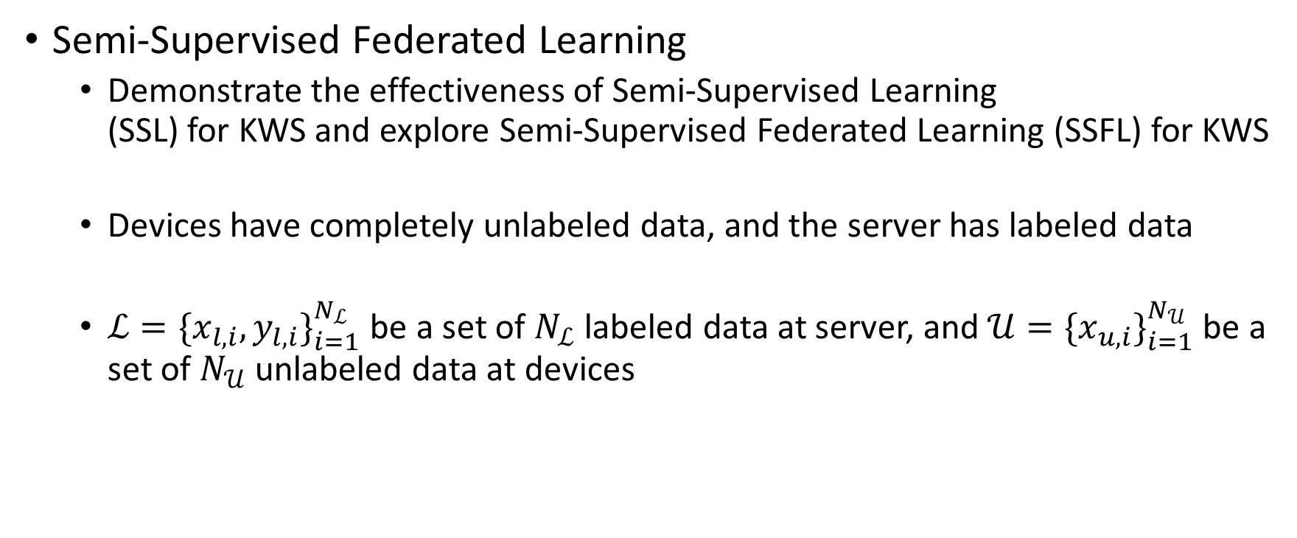
Problem statement
Semi-Supervised Federated Learning
Demonstrate the effectiveness of Semi-Supervised Learning (SSL) for KWS and explore Semi-Supervised Federated Learning (SSFL) for KWS
Devices have completely unlabeled data, and the server has labeled data
$ℒ=\{x_{l,i},y_{l,i}\}_{i=1}^{N_{ℒ}}$ be a set of $N_{ℒ}$ labeled data at server, and $𝒰=\{x_{u,i}\}_{i=1}^{N_{𝒰}}$ be a set of $N_{𝒰}$ unlabeled data at devices
Notes:
In this study, we evaluated the feasibility of applying Semi-Supervised Federated Learning for keyword spotting. Our server possessed labeled data for this process.

Slide 8
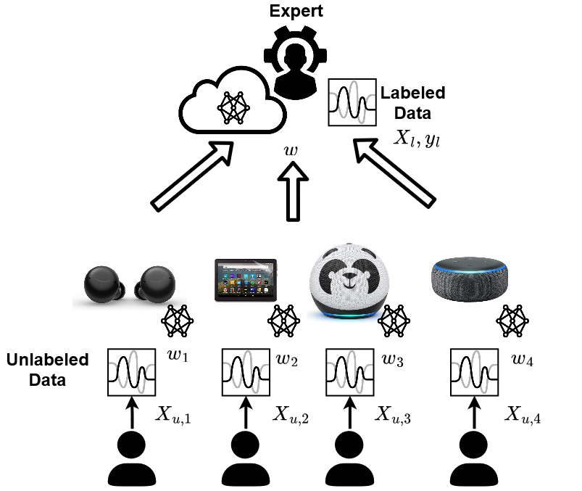
Problem statement
Challenges
Data augmentation on audio data for SSL and SSFL
Statistical heterogeneity of on-device audio data, i.e., insufficient negative samples
Fine-tuning on pretrained teacher model, i.e., expensive to leverage all labeled data at server
Notes:
everal challenges arose during the application of this method. Firstly, we had to determine the most suitable data augmentation method for the problem of KWS and Semi-Supervised Learning. Secondly, we encountered the statistical heterogeneity issue, as negative samples were very scarce. Finally, unlike conventional SSL and SSFL works, we had an abundance of labeled data on the server. Therefore, we focused on fine-tuning the pre-trained teacher model, which was initially trained with extensive labeled data. We then transferred this pre-trained model for a specific cohort and time window, which contained fewer data samples, using the proposed approach.

Slide 9
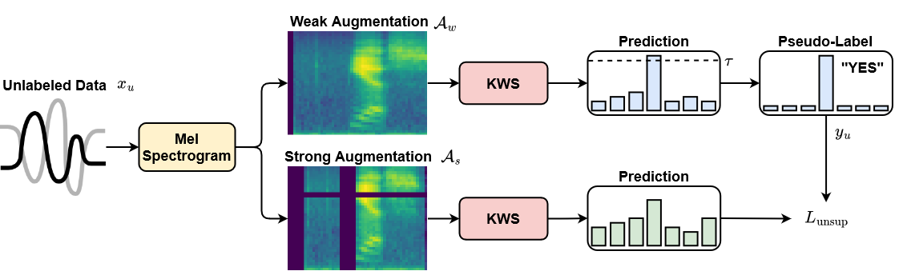
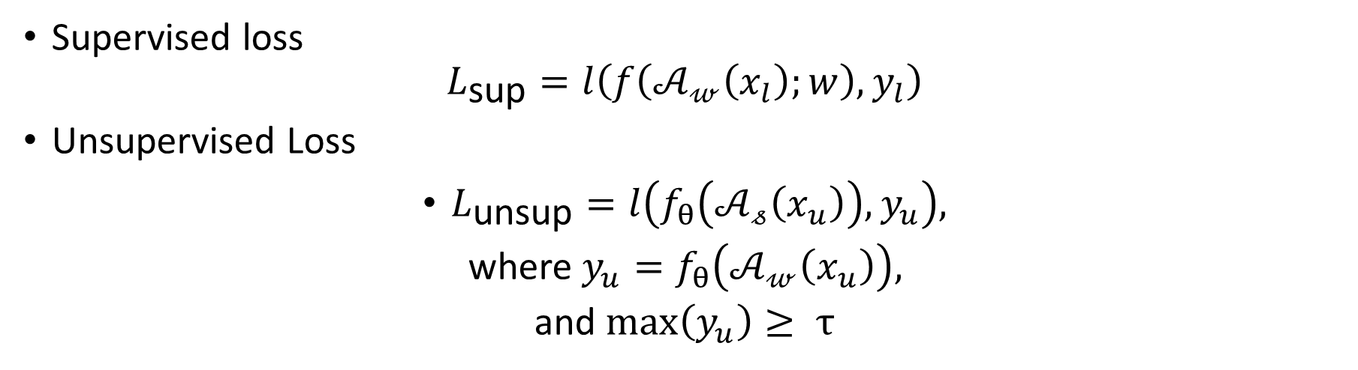
Semi-Supervised Learning
Supervised loss
$$L_{\text{sup}}=l\left(f\left(𝒜_{𝓌}\left(x_{l}\right);w\right),y_{l}\right)$$
Unsupervised Loss
$L_{\text{unsup}}=l\left(f_{θ}\left(𝒜_{𝓈}\left(x_{u}\right)\right),y_{u}\right),$
where $y_{u}=f_{θ}\left(𝒜_{𝓌}\left(x_{u}\right)\right),$
and $\max\left(y_{u}\right)≥ τ$
Notes:
We began by investigating the application of SSL for KWS. Our process incorporated a supervised and an unsupervised loss based on the renowned work, Fixmatch. The unsupervised loss uses a thresholding mechanism for pseudo-labeling to filter out inaccurately labeled data.
where $l\left(⋅\right)$ is the loss function, $𝒜_{𝓌}$ is the weak data augmentation, $w$ is the model parameters, $x_{l}$ and $y_{l}$ are the data and target
Pseudo-labeling with threshold

Slide 10
Keyword Augmentation
Key components of the state-of-the-art SSL methods
Treat Mel Spectrogram as images and study the effect of various data augmentation methods
randomly time shifting and resampling audio streams (BasicAug)⁴
masking frequency and time components (SpecAug)⁵
image-based strong augmentation (RandAug)⁶
mixup (MixAug)⁷
Notes:
Subsequently, we examined various data augmentation methods for KWS, including classical augmentation methods, specaugment, random augment for images, and mixup.

Slide 11
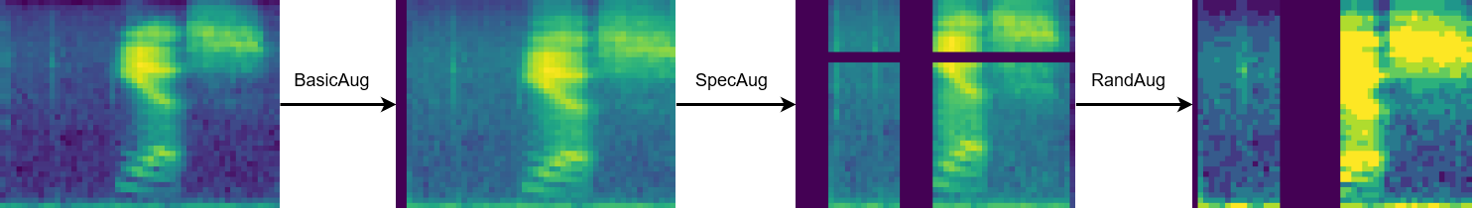
Keyword Augmentation
Strong keyword augmentation
Notes:
This is an example of strong data augmentation based on basic, spec, and random augment.

Slide 12
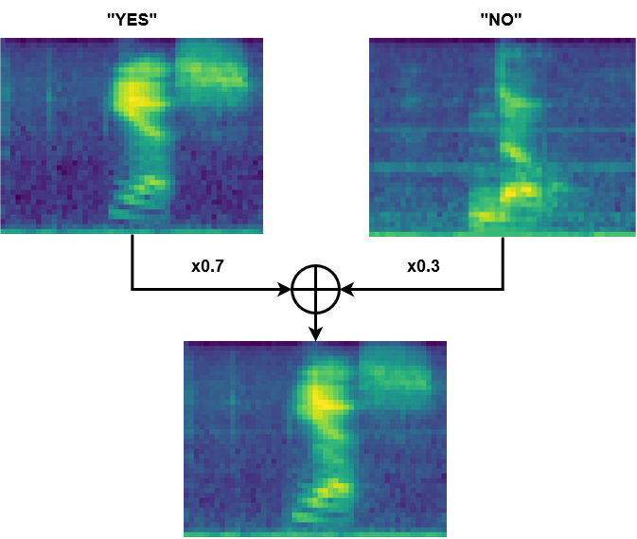
Keyword Augmentation
MixAug
0.7 x “YES” + 0.3 x “NO”
Notes:
This is an example of mixup augmentation.

Slide 13
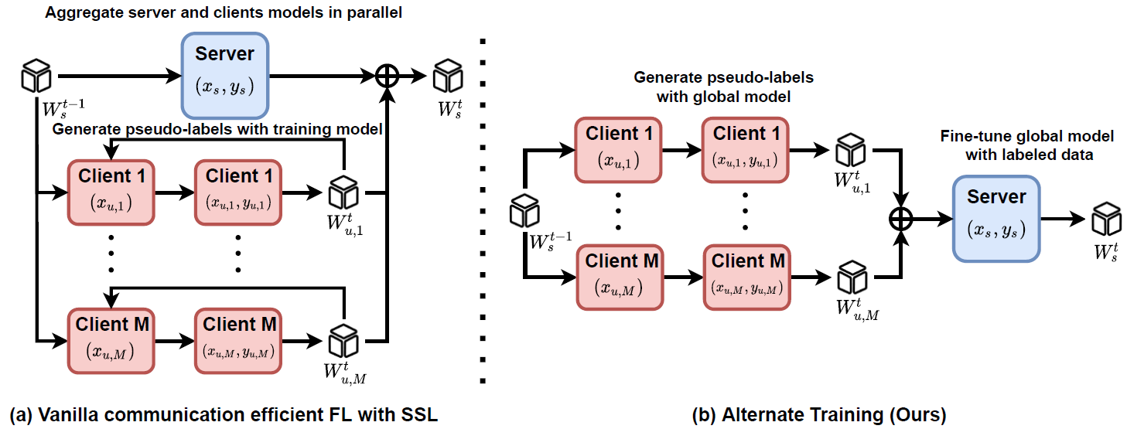
Alternate Training
Fine-tune global model with labeled data
Generate pseudo-labels with global model
Notes:
We utilized alternate training, as proposed in SemiFL, for SSFL. This involved fine-tuning the global model and generating pseudo-labels with the global model.

Slide 14
Alternate Training
Mitigate the issue of statistical heterogeneity
Stabilize the quality of pseudo-labels
Notes:
This approach helped to alleviate the issue of statistical heterogeneity and stabilize the quality of pseudo-labels.

Slide 15
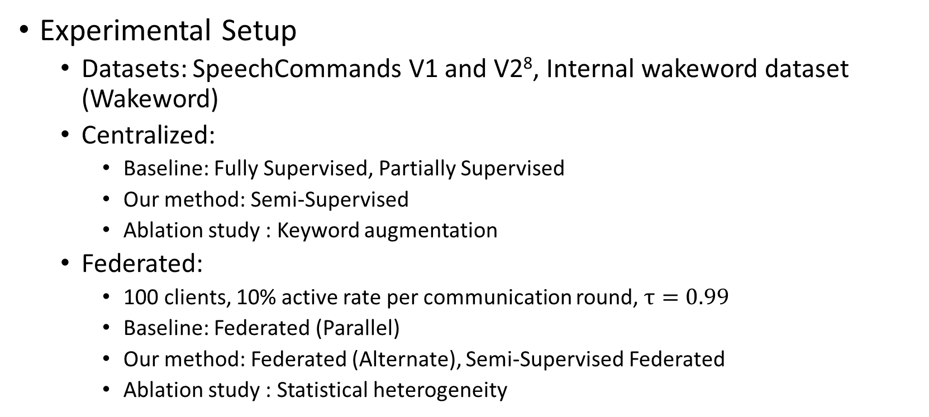
Experiments
Experimental Setup
Datasets: SpeechCommands V1 and V2⁸, Internal wakeword dataset (Wakeword)
Centralized:
Baseline: Fully Supervised, Partially Supervised
Our method: Semi-Supervised
Ablation study : Keyword augmentation
Federated:
100 clients, 10% active rate per communication round, $τ=0.99$
Baseline: Federated (Parallel)
Our method: Federated (Alternate), Semi-Supervised Federated
Ablation study : Statistical heterogeneity
Notes:
In our numerical experiments, we tested on the SpeechCommands datasets and an internal dataset for KWS. We conducted both centralized and federated baselines.

Slide 16
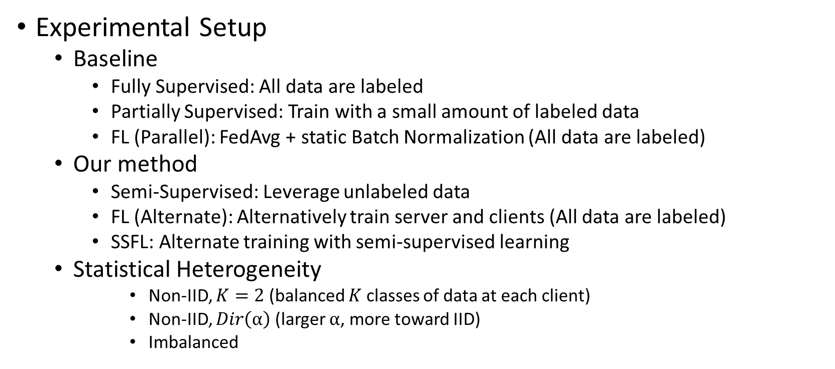
Experiments
Experimental Setup
Baseline
Fully Supervised: All data are labeled
Partially Supervised: Train with a small amount of labeled data
FL (Parallel): FedAvg + static Batch Normalization (All data are labeled)
Our method
Semi-Supervised: Leverage unlabeled data
FL (Alternate): Alternatively train server and clients (All data are labeled)
SSFL: Alternate training with semi-supervised learning
Statistical Heterogeneity
Non-IID, $K=2$ (balanced $K$ classes of data at each client)
Non-IID, $Dir\left(α\right)$ (larger $α$, more toward IID)
Imbalanced
Notes:
The baselines encompassed fully supervised cases (where all data are labeled) and partially supervised cases (where training only used a small amount of labeled data). We also examined the effects of statistical heterogeneity with different data partitions.

Slide 17
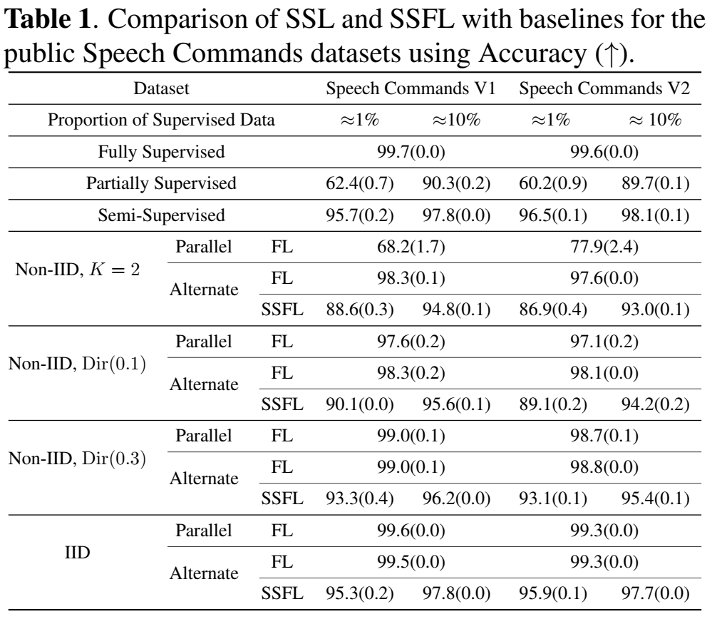
Experiments
SpeechCommands
Number of supervised < 10% (2500) and 1% (250)
Model: TCResNet18⁹ (Temporal Convolution ResNet18)
Class-balanced dataset, 12-way classification
10 opposite keywords ("yes", "no", "up", "down", etc.) + background noise + unknown keywords (a combination of multiple keywords)
Notes:
This the configuration we use for speechcommands dataset. The amount of labeled data we use here is small to demonstrate the applicaiton of SSL and SSFL for KWS without fine-tunning.

Slide 18
Experiments
SpeechCommands
FL (Alternate) outperforms FL (Parallel) for statistically heterogeneous data
SSL and SSFL can significantly improve the case of Partially Supervised and performs close to the case of Fully Supervised
Notes:
Our results demonstrated that FL with Alternate Training outperforms FL with Parallel Training for statistically heterogeneous data. Both SSL and SSFL considerably improved the performance of the Partially Supervised case and were on par with the Fully Supervised case.

Slide 19
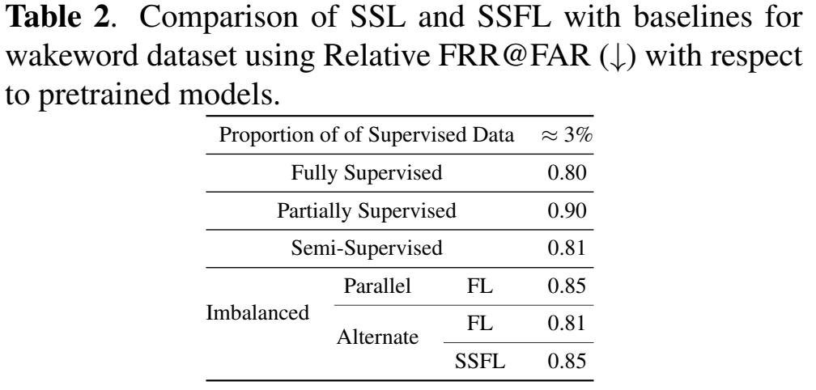
Experiments
Wakeword
Highly imbalanced binary classification (detection) data
Fetch from multiple devices including rook, crown, checkers, bishop, & knight
Performance of pretrained models can be improved with SSFL
Notes:
For the internal dataset, we evaluated performance relative to the baseline pre-trained model. A smaller number denotes better performance. We also faced the statistical heterogeneity issue here due to a lack of negative samples.

Slide 20
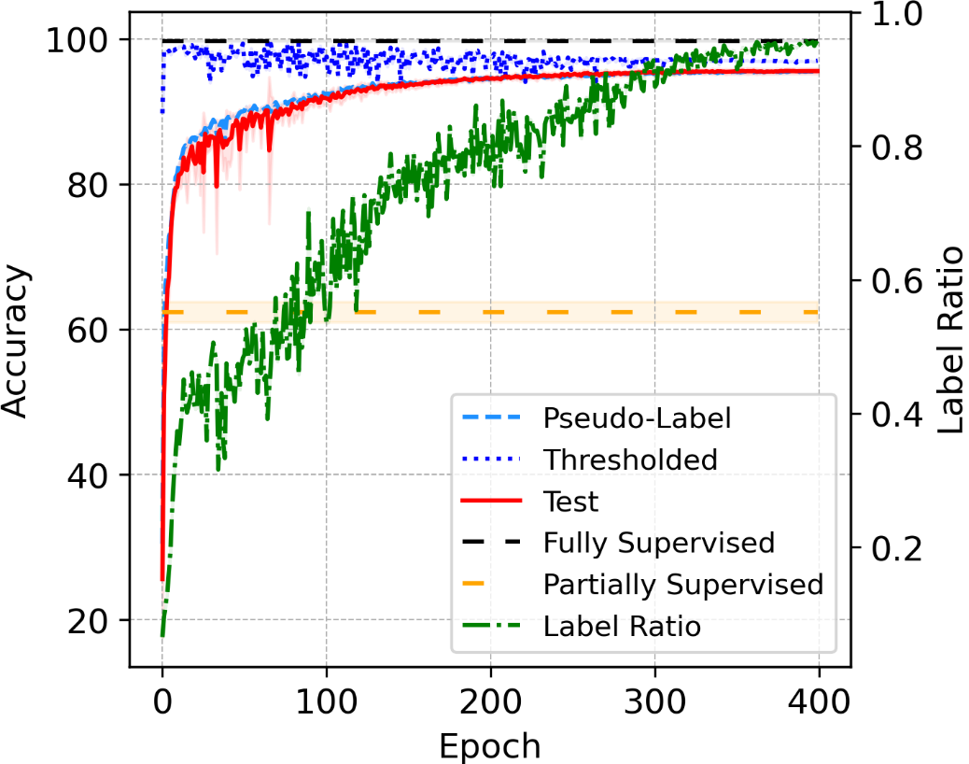
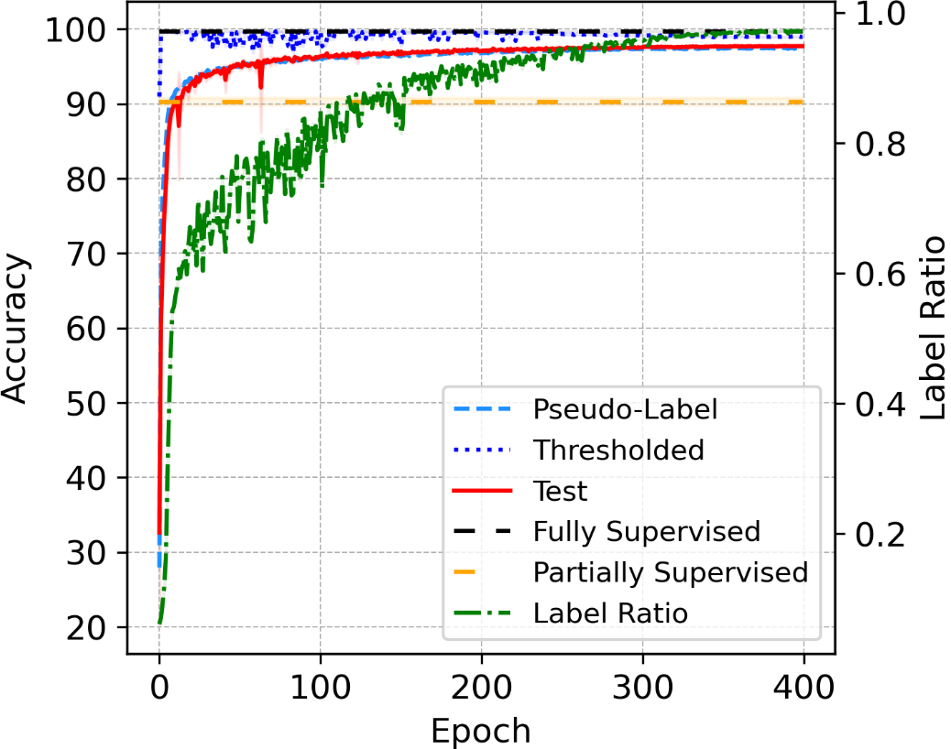
Experiments
SpeechCommands
Quality of Pseudo-labels
Notes:
This is an illustration of learning curves. As you can see, at the end of training, we are actually pseudo-labeling all unlabeled data and we can achieve the perforamnce of fully supervised case.

Slide 21
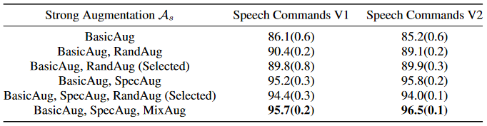

Experiments
Keyword augmentation
Number of Supervised $N_{ℒ}=250$
RandAug (Selected) removes unreasonable augmentation such as Shear
SpecAug alone performs well enough
Notes:
We conduct ablation studies of data augmentations for speech data. The results show that the combbaintion of spec augment and mix augment may be the best solution.

Slide 22
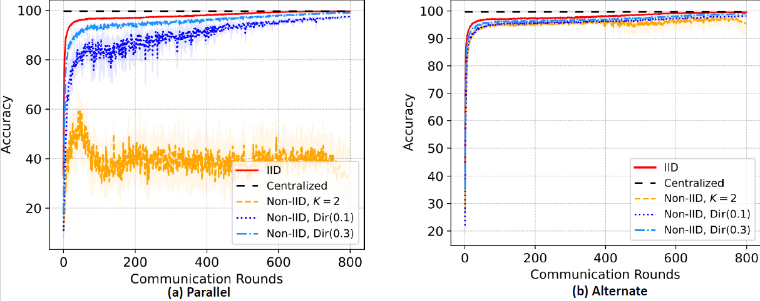

Experiments
Alternate Training
Number of IID data at server $2500$
Notes:
We also conduct ablation studies for alternate training. Alternate training can significantly mitigate the issue of statistical heterogeneity as we can have IID data at server.

Slide 23
Conclusion
SSL and SSFL can be used for Keyword Spotting, but imbalanced supervised data must be considered in practice
SpecAugment and MixAugment on Mel-spectrogram works well for Semi-Supervised Learning
Alternate Training can be used to mitigate the issue of statistical heterogeneity
Pretrained models can be transferred with Semi-Supervised Federated Learning
Notes:
In conclusion, we successfully demonstrated the effectiveness of SSL and SSFL for KWS. Furthermore, we found that spec and mix augment work well for mel-spectrograms, and alternate training can mitigate the issue of statistical heterogeneity. Finally, pre-trained models can be transferred effectively using SSFL.

Slide 24
Future work
Improve the performance of imbalanced Semi-Supervised Federated Learning
Improve the performance of personalization and fairness of various cohorts
Study Semi-Supervised Federated Learning for other applications
Notes:
Future work includes improving the performance of imbalanced semi-supervised federated learning, as the server data could be Non-IID, enhancing the performance of personalization across various cohorts and devices, and exploring the applications of SSFL in other domains.

Slide 25
References
1. McMahan, Brendan, et al. "Communication-efficient learning of deep networks from decentralized data." Artificial intelligence and statistics. PMLR, 2017.
2. Sohn, Kihyuk, et al. "Fixmatch: Simplifying semi-supervised learning with consistency and confidence." Advances in neural information processing systems 33 (2020): 596-608.
3. Diao, Enmao, Jie Ding, and Vahid Tarokh. "SemiFL: Communication efficient semi-supervised federated learning with unlabeled clients." arXiv preprint arXiv:2106.01432 (2021).
4. Rybakov, Oleg, et al. "Streaming keyword spotting on mobile devices." arXiv preprint arXiv:2005.06720 (2020).
5. Park, Daniel S., et al. "Specaugment: A simple data augmentation method for automatic speech recognition." arXiv preprint arXiv:1904.08779 (2019).
6. Cubuk, Ekin D., et al. "Randaugment: Practical automated data augmentation with a reduced search space." Proceedings of the IEEE/CVF conference on computer vision and pattern recognition workshops. 2020.
7. Zhang, Hongyi, et al. "mixup: Beyond empirical risk minimization." arXiv preprint arXiv:1710.09412 (2017).
8. Warden, Pete. "Speech commands: A dataset for limited-vocabulary speech recognition." arXiv preprint arXiv:1804.03209 (2018).
9. Fallah, A., Mokhtari, A., & Ozdaglar, A. “Personalized federated learning: A meta-learning approach”, 2020, arXiv preprint
10. Li, T., Hu, S., Beirami, A., & Smith, V. “Ditto: Fair and robust federated learning through personalization”. 2020, ICML
11. Collins, Liam, et al. "Exploiting shared representations for personalized federated learning." International Conference on Machine Learning. PMLR, 2021.

Slide 26


Thank You
Notes:
Thank you.

